Slide 1
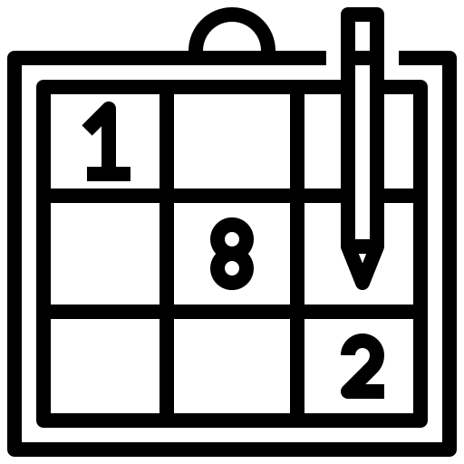
MATH SUBJECT FOR HIGH SCHOOL
Sudoku Solver
Quadratic Functions
Final Project
Introduction to Software engineering

Slide 2
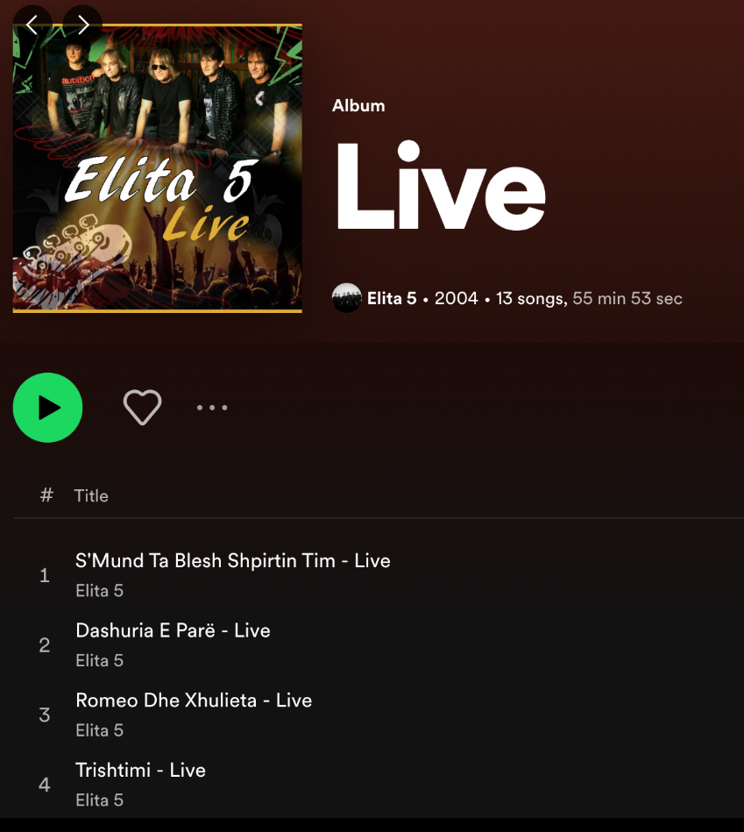
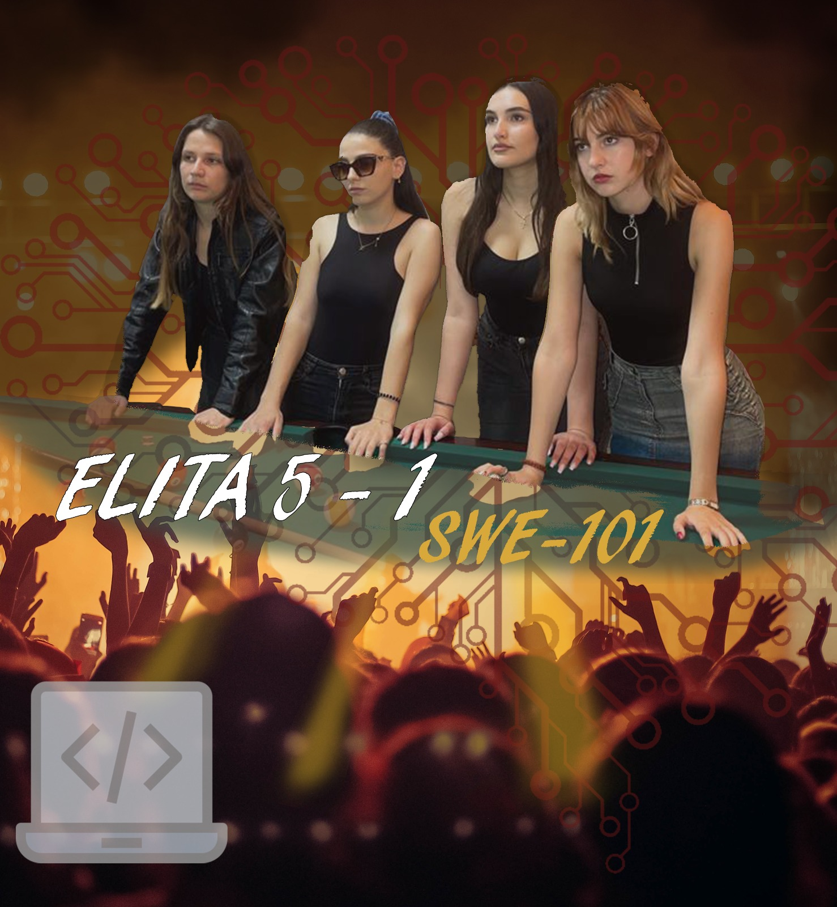
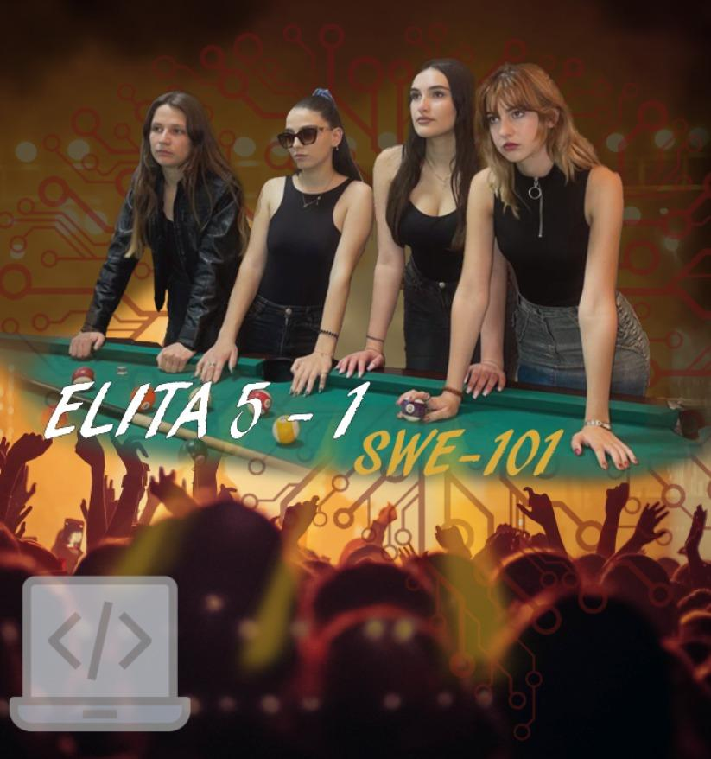
Elita 5-1
Aurora Zhibaj………………….
Ema Kola………………….
Keit Nika………………….
Klea Faqolli………………….

Slide 3
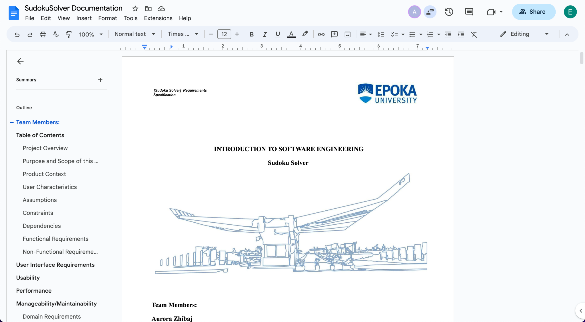
Collaboration
We dropped an initial split of the work for a more cooperative approach.
A mix of remote and on-site meetings were held.
Google Docs was the shared platform in which we worked on for the project documentation.
As they say two is better than one, therefore four is even better.

Slide 4
Project Requirements
Negotiation.

Slide 5
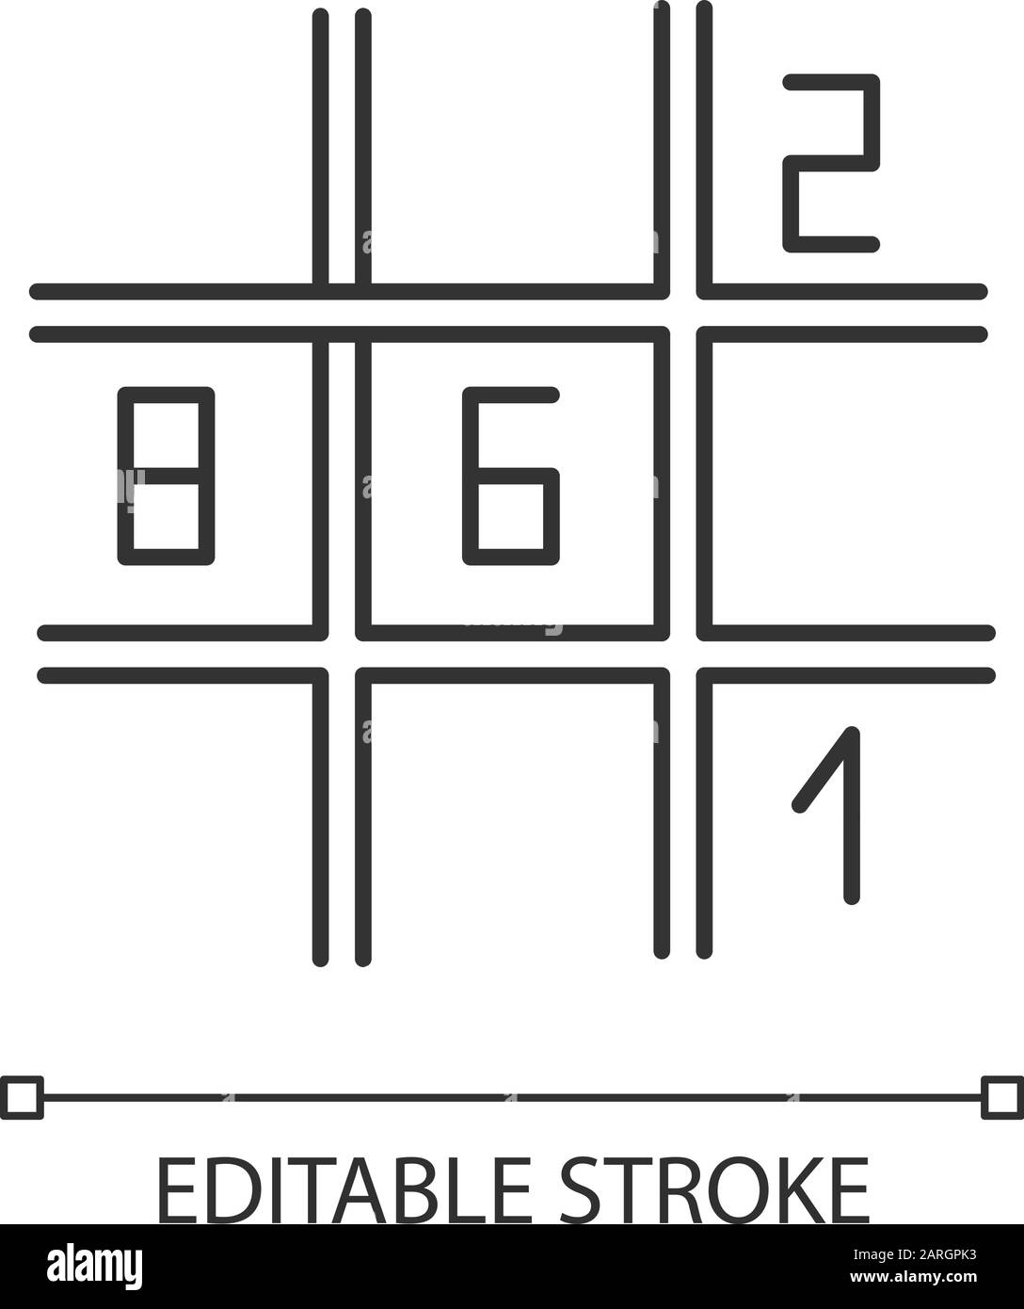
User Interface: The Sudoku Solver should have a user-friendly interface that allows users to input the Sudoku puzzle and view the solution. The interface should include an input form for entering the puzzle and a display area for showing the solution.
Input Validation: The Sudoku Solver should validate user input to ensure that it is a valid Sudoku puzzle. It should also validate user input to ensure that the puzzle is solvable.
Algorithm Design: The Sudoku Solver should use a suitable algorithm for solving the puzzle. The algorithm should be able to handle various puzzle sizes, including standard 9x9 puzzles and larger puzzles.

Slide 6
Documentation: The project should be well-documented, including user manuals, source code documentation, and project reports.
Testing: The Sudoku Solver should be thoroughly tested to ensure that it works correctly and accurately. This should include testing with various puzzle sizes.
Error Handling: The Sudoku Solver should handle errors such as invalid input, unsolvable puzzles.
Performance Optimization: The Sudoku Solver should be optimized for performance, so that it can solve puzzles quickly and efficiently. This could include techniques such as backtracking and pruning.

Slide 7
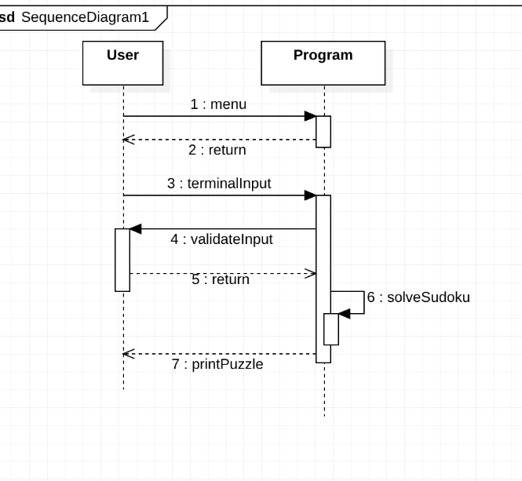
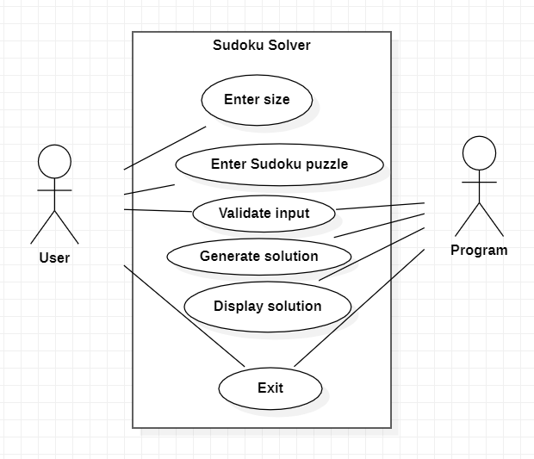
Schematic Diagram Models

Slide 8
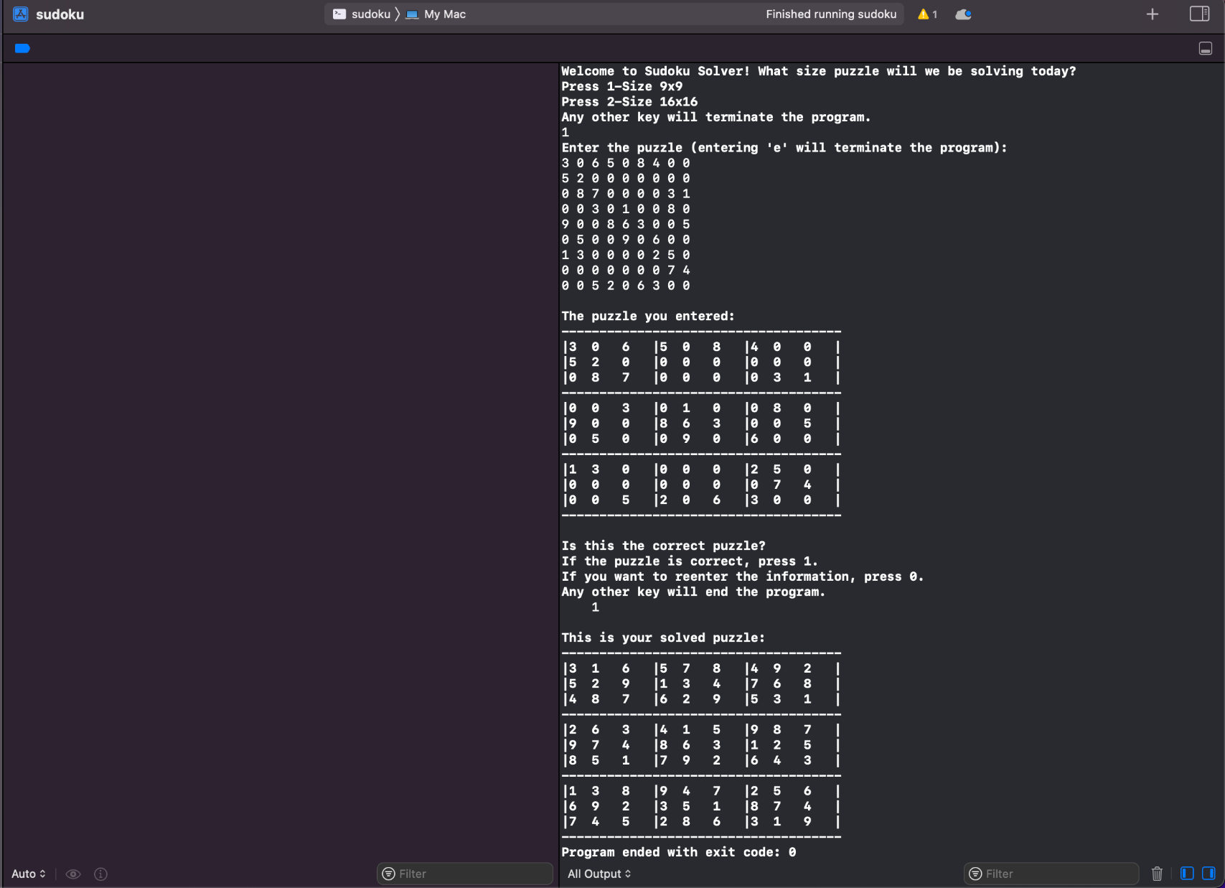
Terminal User Interface

Slide 9
Github Collaboration
Rather than working in parallel, this kind of project demanded a sequential approach.
Before working on another branch, the previous branches had to be merged into the main.

Slide 10
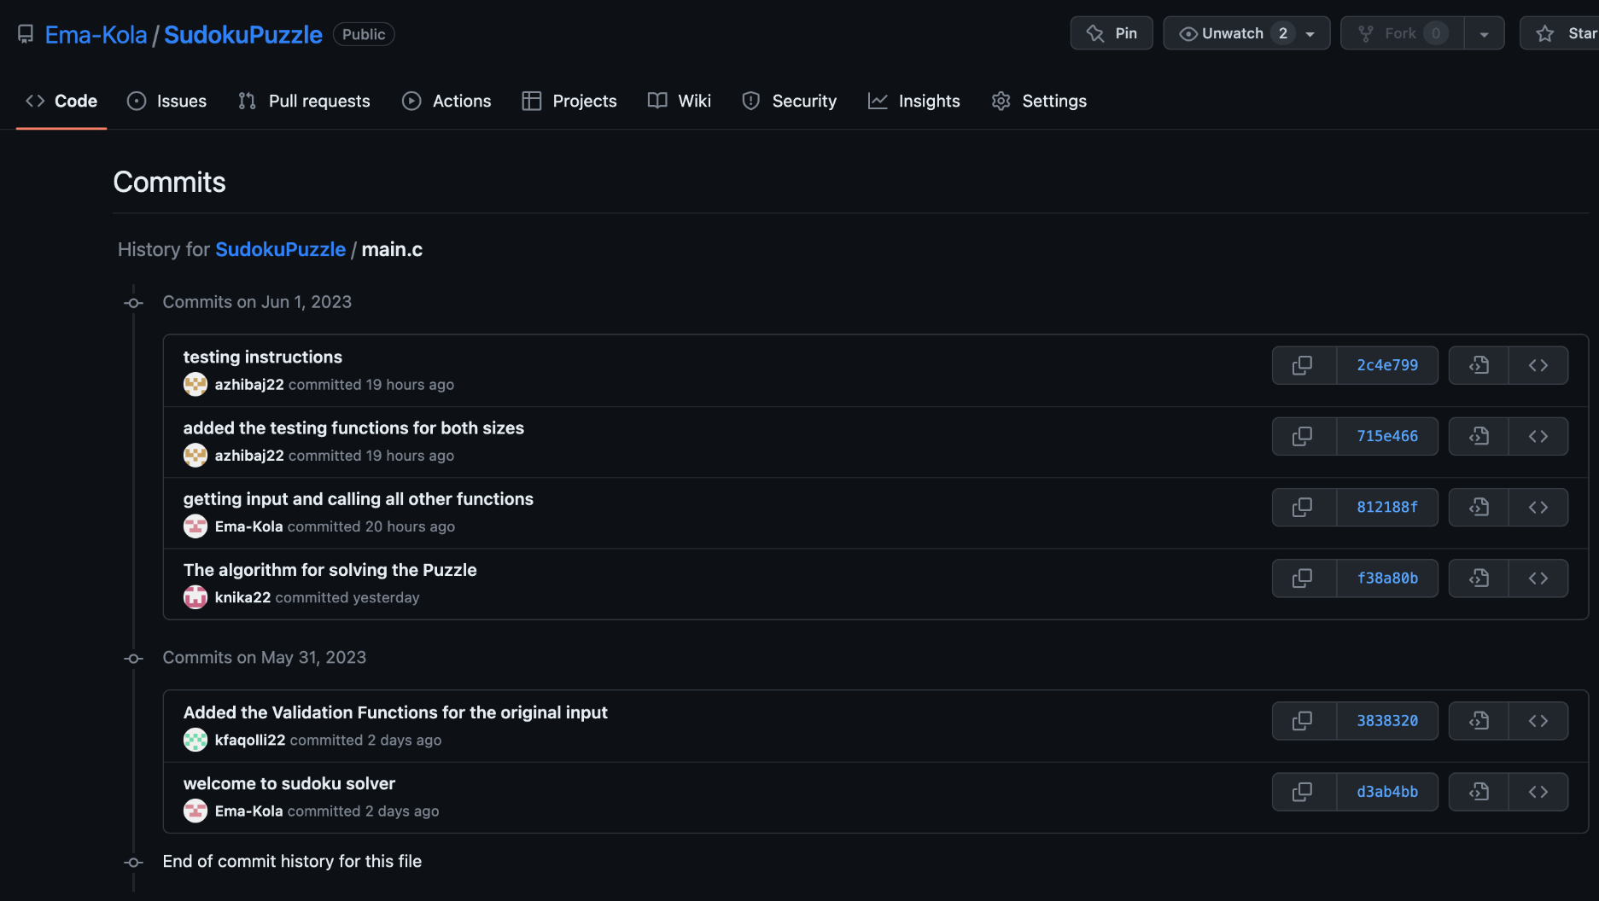
Github Collaboration
Cloning and creating a new branch.
Building upon the previous code, pushing and creating a pull request, merging

Slide 11
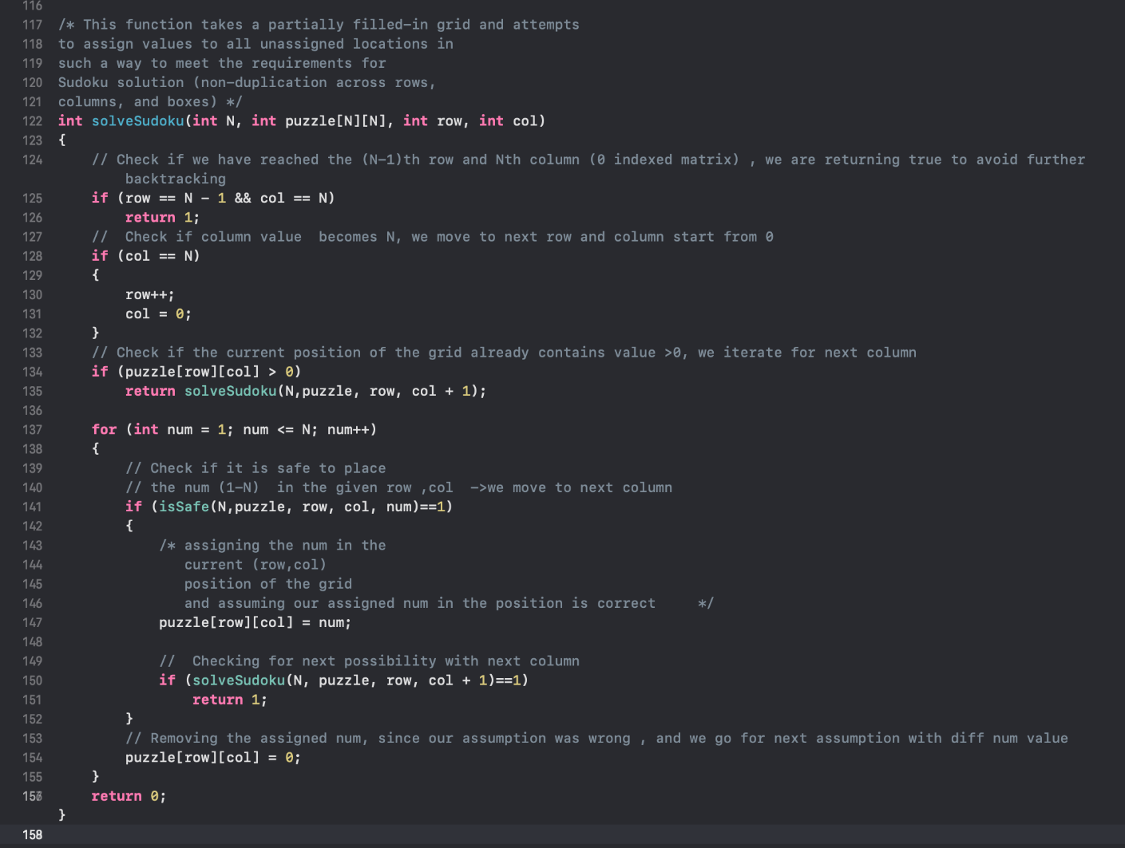
Backtracking algorithm

Slide 12
Monitoring and Error Handling
When the user enters a puzzle, the program gives the chance to double check the input so no errors will occur.
The program provides the option to either input new values or terminate the program.
Even after checking a second time, if the user still gives an incorrect or invalid input The Sudoku Solver will catch it and display a message informing the user.

Slide 13
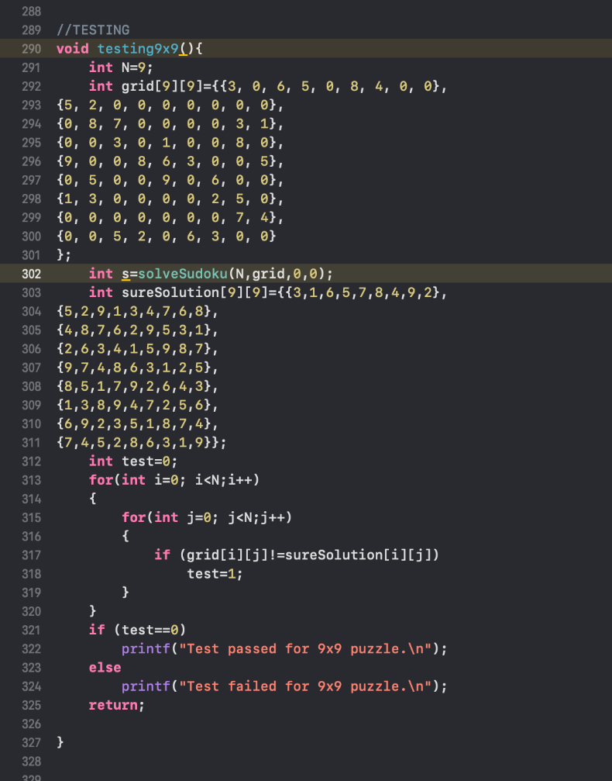

Testing

Slide 14
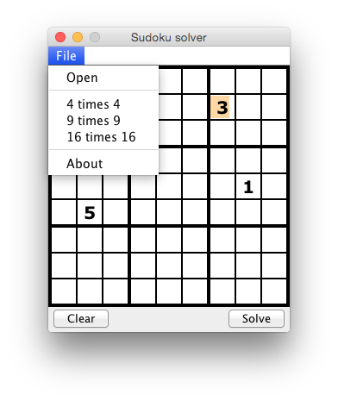
Technical Limitations
Limited support for creating a graphical user interface(GUI) for a Sudoku Solver using C .
Implementing a Sudoku grid is more challenging to do in CodeBlocks and Xcode compared to specialized GUI frameworks.
A Sudoku Solver which was created using Java

Slide 15
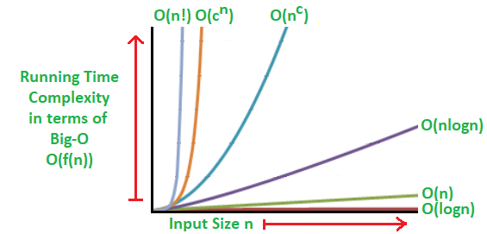
Technical limitations
We wanted to make it easier for the user to understand which number is the input, and which is generated by the program through different colors, however we were not able to do it in the terminal space.
Our algorithm is not very efficient on larger puzzles as execution time exponentially grows.

Slide 16
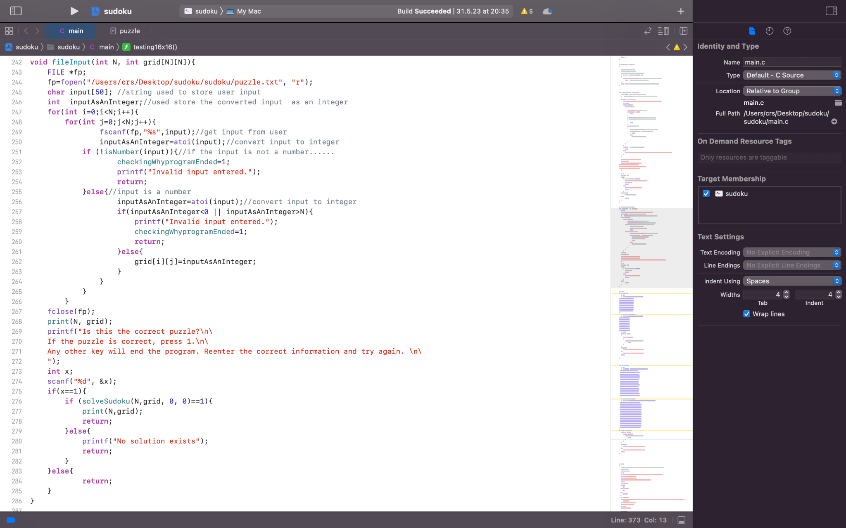
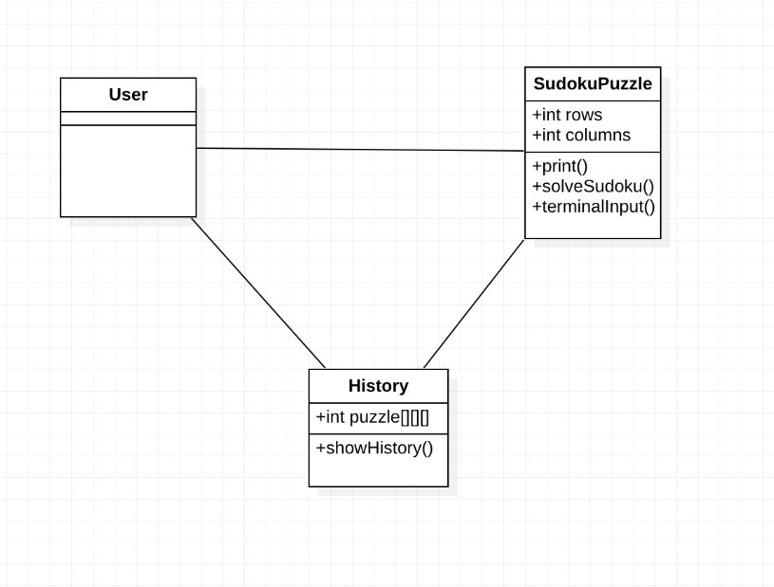
Future developments

Slide 17
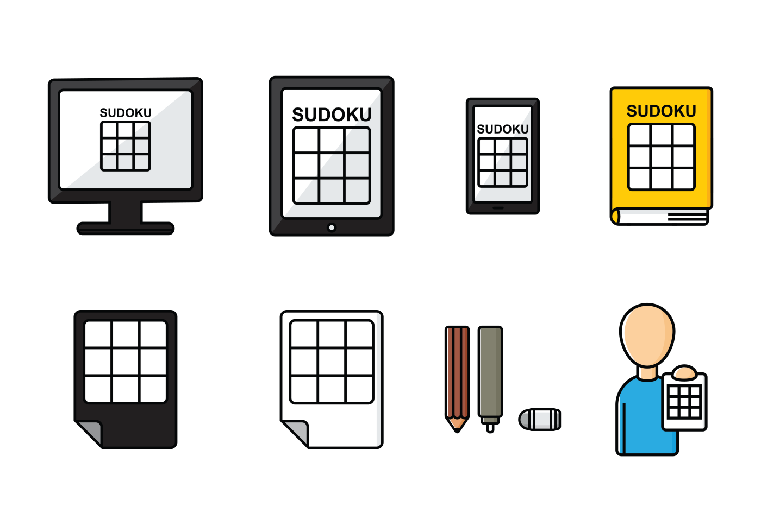
Thank you
and rock on !

